Slide 1

M-TV Research presents:
Vanguard
project
Maurits Siemonsma - To Van Cao

Slide 2

Outline
Research objective
Preliminary analysis
Hypotheses formed
Analysis of KPI’s
Other findings
Conclusion
Advice
Challenges
Further developments
H₁
H₂
H₃
M-TV

Slide 3
Research objective
Testing and comparison of a new User Interface (UI) design to improve client experience and onboarding rates.
Start
Step 1
Step 2
Step 3
Confirm
M-TV

Slide 4

Does a well-designed website UI contribute to higher KPI performance?
M-TV

Slide 5
Does a well-designed website UI contribute to higher KPI performance?
It probably depends…
M-TV

Slide 6




LIMITED TIME OFFER!
GET INSURED TODAY!
Life insurances
House insurances
Car insurances
… And so much more!
For a free consultation, please call 00 35 024 125 125
!!! -> Or click this button:
Global renowned insurer in all types of insurances:
M-TV

Slide 7

LIMITED TIME OFFER!
GET INSURED TODAY!
Life insurances
House insurances
Car insurances
… And so much more!
For a free consultation, please call 00 35 024 125 125
!!! -> Or click this button:
Global renowned insurer in all types of insurances:
M-TV

Slide 8
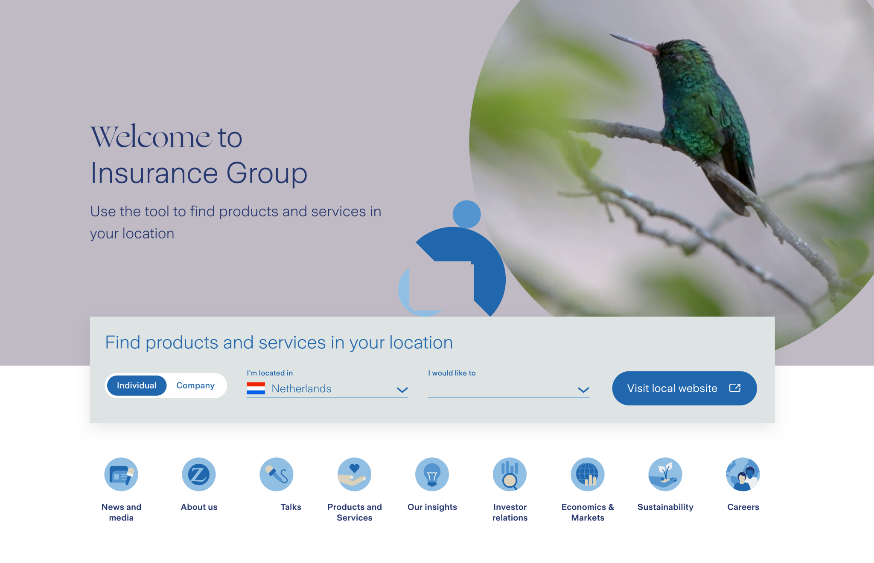
Welcome to Vanguard Insurance Inc.
M-TV

Slide 9
Preliminary Analysis
Group comparison: are they weighted equally?
Exploring data: what is available?
Data cleaning : outliers suppression
Defining KPIs:
Time-related
Count-related
Age-related
Error definition = return to previous step, i.e. “back step”
M-TV

Slide 10
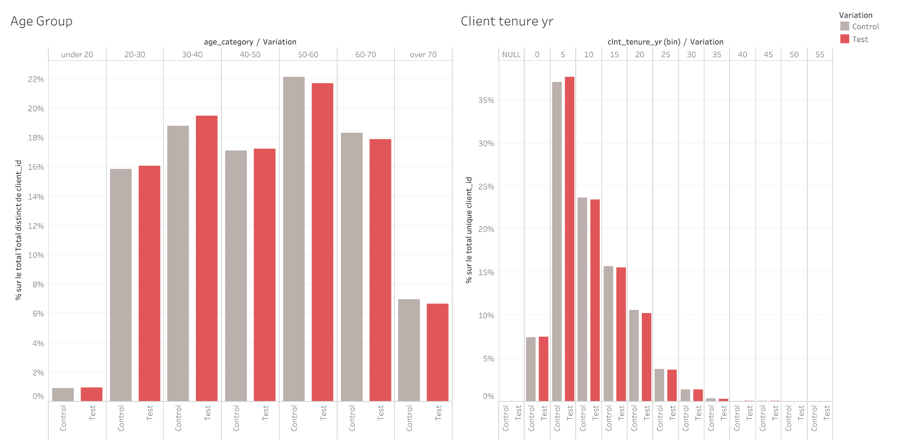
Sample groups presentation
Sample group Control & Test are balanced :
age wise
tenure wise
participants wise
UI design will be the only variating factor
Control | 26 K clients
Test | 23 K clients
M-TV

Slide 11
Hypothesis formed
H₁
New UI design results in higher completion rates
M-TV

Slide 12
Hypothesis formed
H₁
H₂
New UI design results in higher completion rates
New UI design results in faster onboarding times
M-TV

Slide 13
Hypothesis formed
H₁
H₂
H₃
New UI design results in higher completion rates
New UI design results in faster onboarding times
New UI design results in lower error rates
M-TV

Slide 14
KPI:
Completion rate =
H₁: Conversion rate
KPI:
Sum completed participants
Completion rate =
Sum participants at start
M-TV

Slide 15
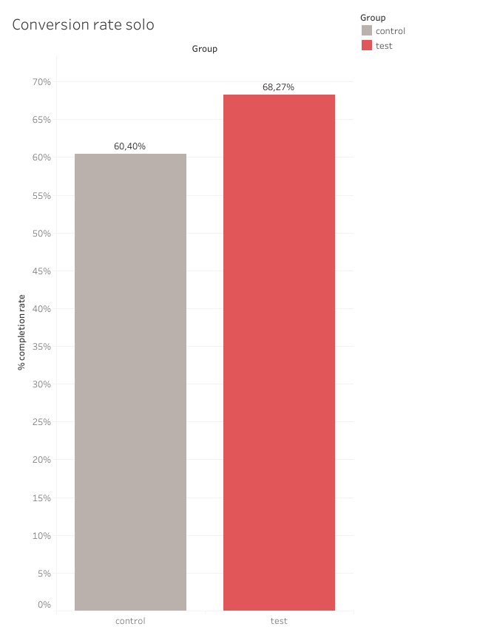
KPI:
Completion rate =
H₁: Conversion rate
+13,0 %
Exceeds +5% profitability threshold
KPI:
Sum completed participants
Completion rate =
Sum participants at start
M-TV

Slide 16
H₁: Conversion rate
+13,0 %
Exceeds +5% profitability threshold
KPI:
Sum completed participants
Completion rate =
Sum participants at start
H₀: Test group < control group +5%
H₁: Test group > control group +5%
Alpha: 0,05
T-statistic: 4,41370
One-sided P-value: 0,00225
Outcome: reject null-hypothesis
(p. value < 0,05 and t-stat > 0)
M-TV

Slide 17
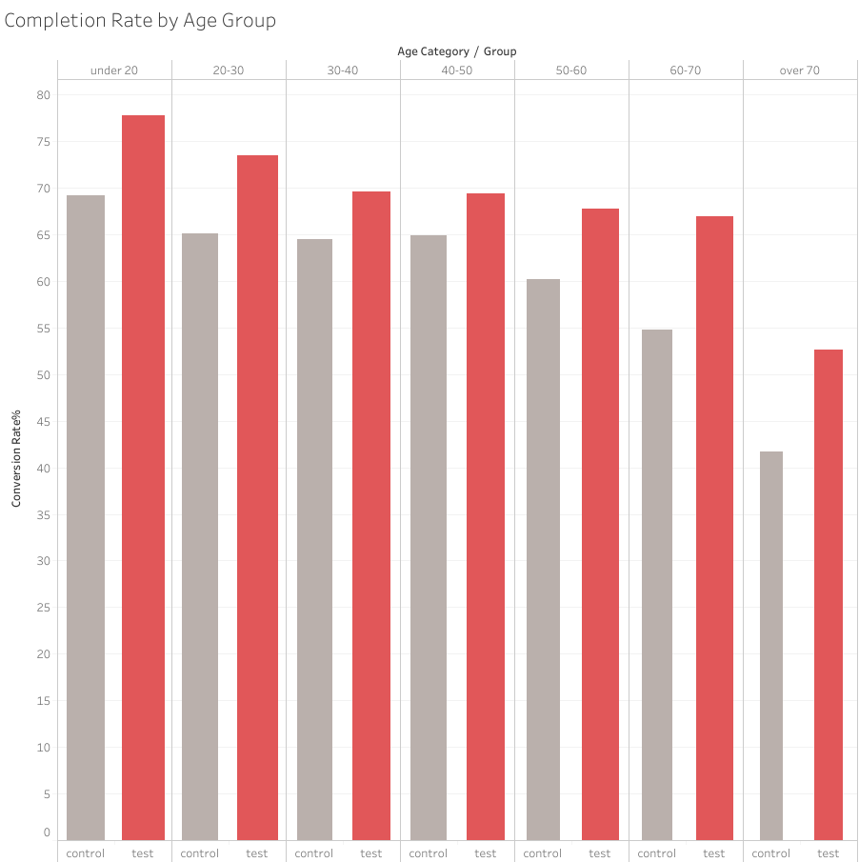
H₁: Conversion rate (cont.)
+8,6 %
+8,5 %
+7,6 %
+12,1 %
+13,0 %
+10,8 %
M-TV

Slide 18
H₁: Conversion rate (cont.)
- Youngest and oldest age group onboard most
+8,6 %
+8,5 %
+7,6 %
+12,1 %
+13,0 %
+10,8 %
M-TV

Slide 19
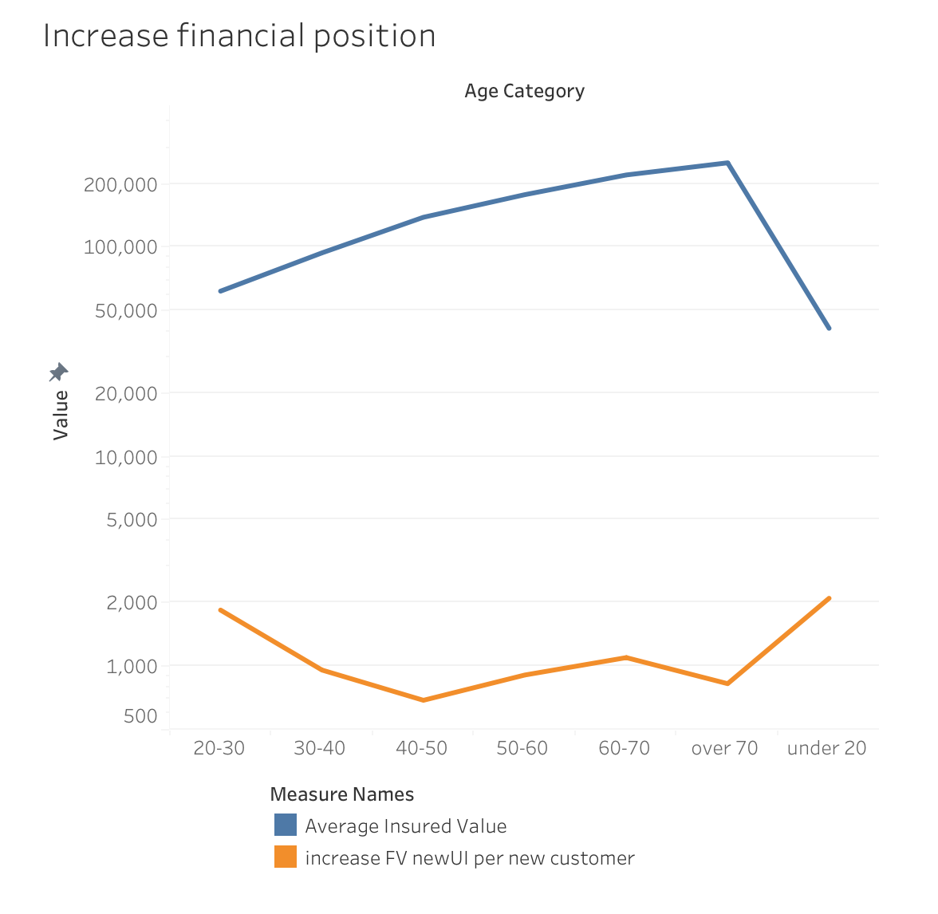
H₁: Implied financial impact
Discounted cash flows
Considering Future Value of present cash flows: prominent increases in onboarding in the highest and lowest age-groups resulted in an significant implied financial result.
M-TV

Slide 20
H₁: Implied financial impact
Discounted cash flows
Considering Future Value of present cash flows: prominent increases in onboarding in the highest and lowest age-groups resulted in an significant implied financial result.
Insurance sellers tend to collect longer from your clients than older due to mortality, consequently resulting in a higher future value of cash flows.
M-TV

Slide 21
Implied financial impact
Considering Future Value of present cash flows: prominent increases in onboarding in the highest and lowest age-groups resulted in an significant implied financial result.
Insurance sellers tend to collect longer from your clients than older due to mortality, consequently resulting in a higher future value of cash flows.
M-TV

Slide 22
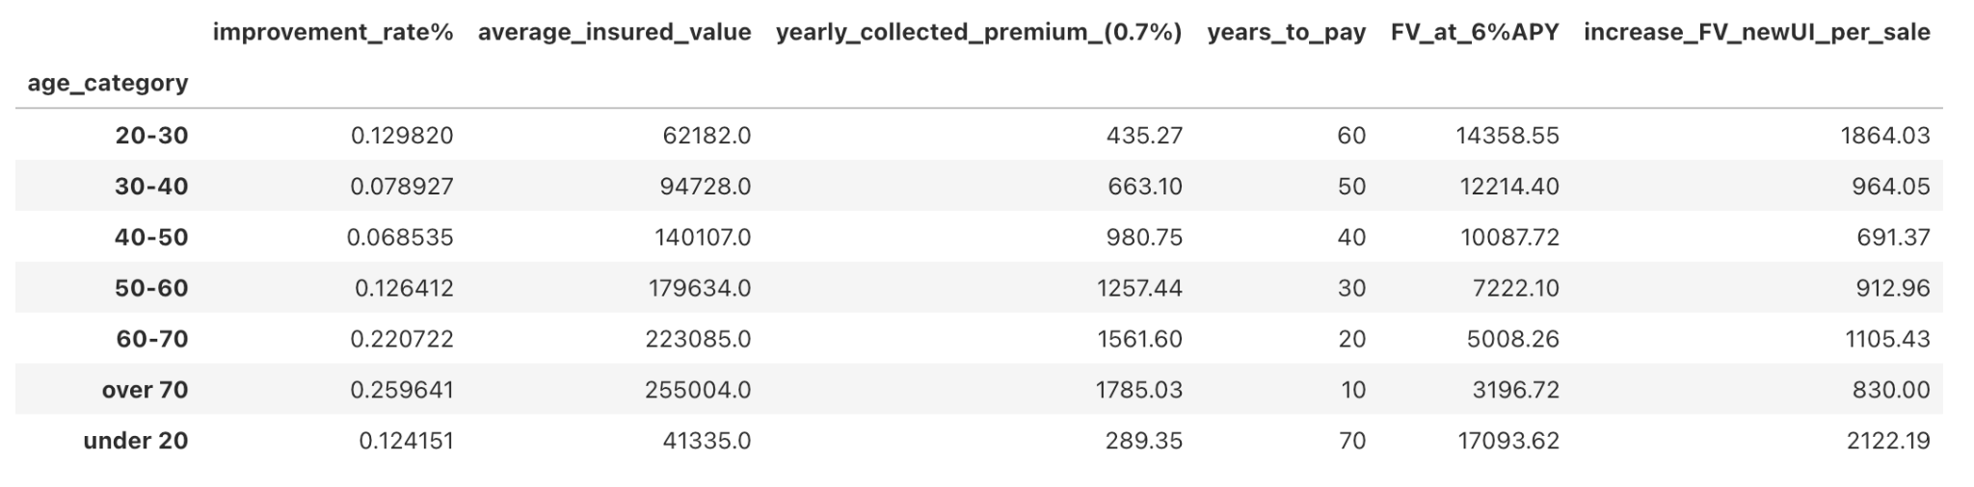
Implied financial impact
Considering Future Value of present cash flows: prominent increases in onboarding in the highest and lowest age-groups resulted in an significant implied financial result.
Insurance sellers tend to collect longer from your clients than older due to mortality, consequently resulting in a higher future value of cash flows.
M-TV

Slide 23
H₂: Completion Time
KPI:
Average
Completion = Time
Sum of Duration Time
Count of client
M-TV

Slide 24
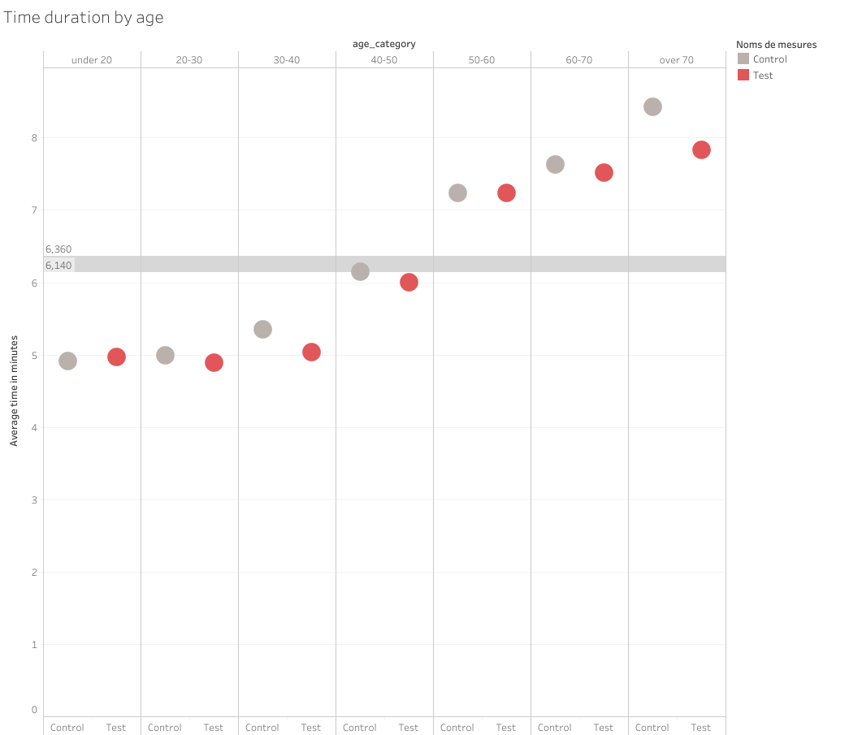
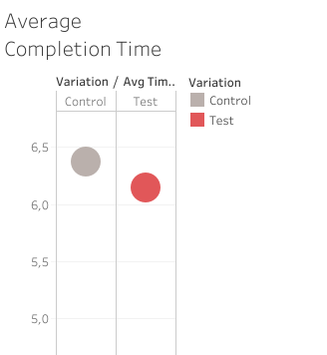
H₂: Completion Time
KPI:
Average
Completion = Time
Sum of Duration Time
Count of client
-3,6%
Older groups (over 50) have higher average completion time
M-TV

Slide 25
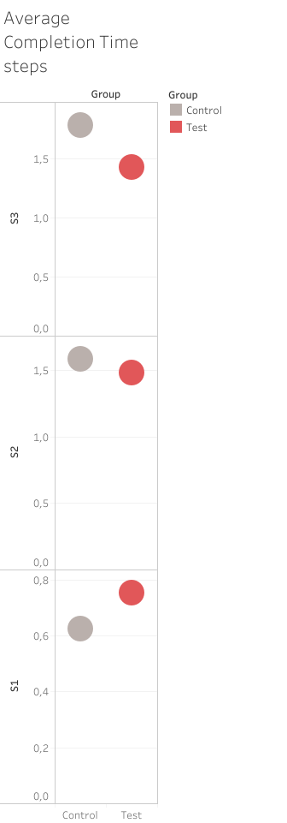
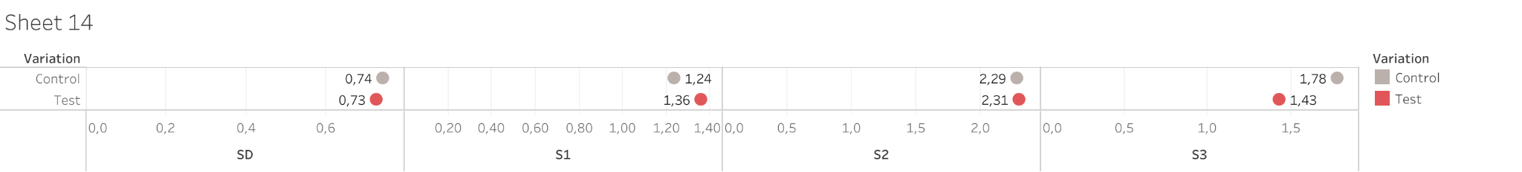
H₂: Completion Time - participants spend most time on step 2
KPI:
Average
Completion = Time
Sum of Duration Time
Count of client
Start
Step 1
Step 2
Step 3
Variance Test vs Control
-1,35 %
+9,68 %
+0,87 %
-19,66 %
M-TV

Slide 26
H₃: Error rate
Error Rate
Control | 31,37%
Test | 25,69% ( -22,11 %)
KPI:
Count of errors
Total of participants who started the process
Error rate =
M-TV
Notes:
Findings:
The error rate of the test group was 25.69%, while the error rate of the control group was 31.37%.
The improvement of error rate in the test group was 22.11%.

Slide 27
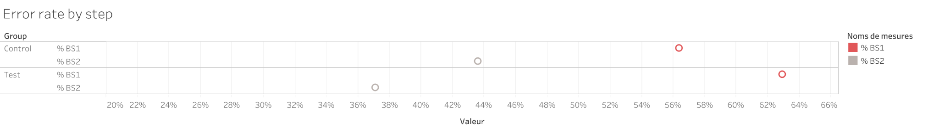
H₃: Error rate - Step 2 causes most errors
Error Rate
Control | 31,37%
Test | 25,69% ( -22,11 %)
KPI:
Count of errors
Total of participants who started the process
Error rate =
Start
Step 1
Step 2
Step 3
Confirm
M-TV
Notes:
Findings:
The error rate of the test group was 25.69%, while the error rate of the control group was 31.37%.
The improvement of error rate in the test group was 22.11%.

Slide 28
Hypothesis answering
H₁
H₂
H₃
New UI design results in higher completion rates
New UI design results in faster onboarding times
New UI design results in lower error rates
M-TV

Slide 29
Hypothesis answering
H₁
H₂
H₃
New UI design results in higher completion rates
True: test group performed significantly better by more than 5%.
New UI design results in faster onboarding times
New UI design results in lower error rates
M-TV

Slide 30
Hypothesis answering
H₁
H₂
H₃
New UI design results in higher completion rates
True: test group performed significantly better by more than 5%.
New UI design results in faster onboarding times
New UI design results in lower error rates
M-TV

Slide 31
Hypothesis answering
H₁
H₂
H₃
New UI design results in higher completion rates
True: test group performed significantly better by more than 5%.
New UI design results in faster onboarding times
True: test group performed better with 3,6% faster
New UI design results in lower error rates
M-TV

Slide 32
Hypothesis answering
H₁
H₂
H₃
New UI design results in higher completion rates
True: test group performed significantly better by more than 5%.
True: test group performed better with 3,6% faster
New UI design results in faster onboarding times
True:
New UI design results in lower error rates
M-TV

Slide 33
Hypothesis answering
H₁
H₂
H₃
New UI design results in higher completion rates
True: test group performed significantly better by more than 5%.
True: test group performed better with 3,6% faster
New UI design results in faster onboarding times
True:
New UI design results in lower error rates
True: test group reduced errors by 22,11%
M-TV

Slide 34
Conclusion / Advice
Our findings indicate that not only did the new UI meet the threshold criteria set by Vanguard :
It overperformed the metrics substantially;
It is therefore our advice to implement the new UI into production.
M-TV

Slide 35
Conclusion / Advice
Our findings indicate that not only did the new UI meet the threshold criteria set by Vanguard :
It overperformed the metrics substantially;
It is therefore our advice to implement the new UI into production.
Onboarding duration time was in general improved, but most of the ground won was with error rates (-22,11%).
Interestingly, the new UI seemed to have appealed to the youngest and oldest participants in both groups, which in turn account for the highest implied revenue. It is key to retain these younger clients since these cash-flows can be reinvested the longest.
M-TV

Slide 36
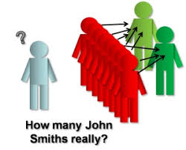


Challenges
Data cleaning decision
Data Rabbit Hole
Python vs Tableau
compatibility
M-TV

Slide 37
Recommendations
Onboarding Process needs to be faster
UI developer is recommended to still look into how to improve UI since target of -5% is missed by 1.4%
M-TV
Notes:
UI developer is recommended to still look into ways how to improve UI to make the onboarding process faster since target of -5% is missed by 1.4%;
Step 2 causes more errors in the new UI than the old;

Slide 38
Recommendations
Onboarding Process needs to be faster
Step 2 needs to be improved in priority
UI developer is recommended to still look into how to improve UI since target of -5% is missed by 1.4%
Step 2 causes more errors in the new UI than the old one
M-TV
Notes:
UI developer is recommended to still look into ways how to improve UI to make the onboarding process faster since target of -5% is missed by 1.4%;
Step 2 causes more errors in the new UI than the old;

Slide 39
Recommendations
Onboarding Process needs to be faster
Step 2 needs to be improved in priority
Client retention
UI developer is recommended to still look into how to improve UI since target of -5% is missed by 1.4%
Step 2 causes more errors in the new UI than the old one
Challenge to retain younger clients even if older clients accounts for most value now
M-TV
Notes:
UI developer is recommended to still look into ways how to improve UI to make the onboarding process faster since target of -5% is missed by 1.4%;
Step 2 causes more errors in the new UI than the old;

Slide 40
Recommendations
Onboarding Process needs to be faster
Step 2 needs to be improved in priority
Client retention
UI developer is recommended to still look into how to improve UI since target of -5% is missed by 1.4%
Step 2 causes more errors in the new UI than the old one
Challenge to retain younger clients even if older clients accounts for most value now
Next Steps : Qualitative Survey
As the data set was giving no qualitative information on the UI conducting a qualitative analysis on the UI would complete the research
M-TV
Notes:
UI developer is recommended to still look into ways how to improve UI to make the onboarding process faster since target of -5% is missed by 1.4%;
Step 2 causes more errors in the new UI than the old;

Slide 41
Thank you for your attention!
Maurits Siemonsma - To Van Cao
M-TV

